Slide 1
Very Deep Convolution Network for Super Resolution
Deep-Learning Project CS 577
Gabriel Baranes, CWID : A20521263
Sahil Riyaz Sheikh, CWID : A20517693

Slide 2

What is super resolution
Before getting into the nitty gritty of super resolutions, let us understand some concepts regarding images.
What is an image?
What is resolution?

Slide 3
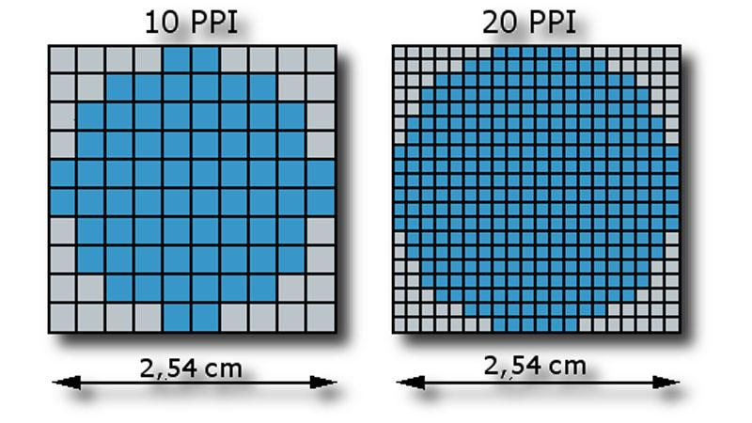
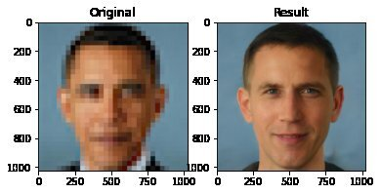


Slide 4
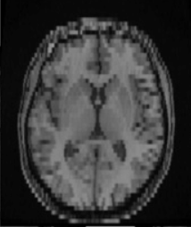
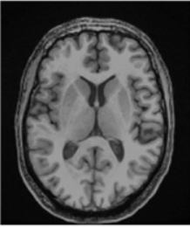
Introduction
Image Super-Resolution: Low Resolution image to High Resolution image
Usefulness: medical field, security, Biological field.
Existing deep learning technique and its problem: SRCNN -small image regions, slow, single scale
LR image
HR image

Slide 5
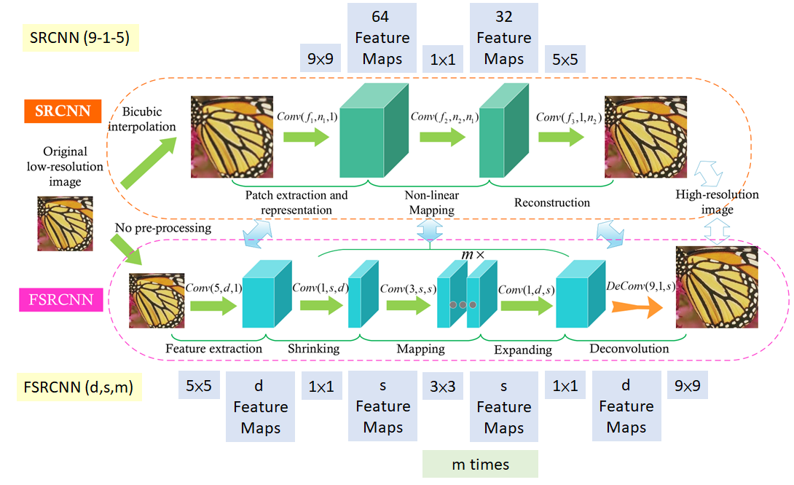
Previous models

Slide 6
Problem Statement
How to implement a better Image Super-Resolution network that works better than SRCNN?
SRCNN | Our network
Small Images | Big Images
Slow | Fast
Uni-Scale | Multi-Scale

Slide 7
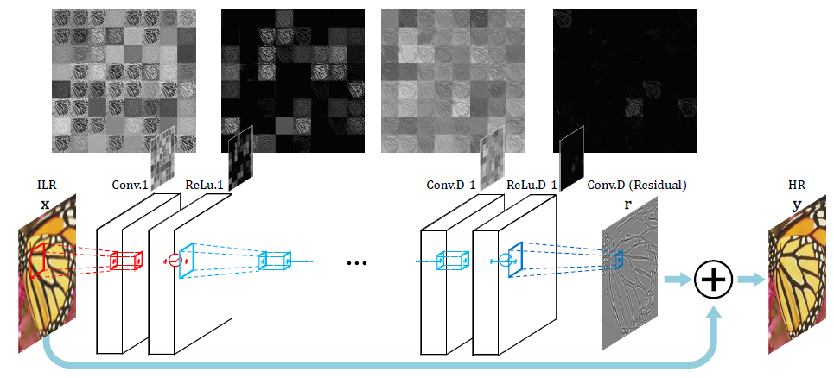
VDSR Network
Use a very deep convolutional network inspired by K.Simonyan and A.Zisserman
Deep Convolution-layers network

Slide 8
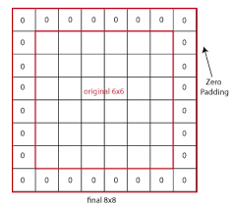
Issue with using a very deep network to predict dense outputs:
Size of the feature map gets reduced every time convolution operations are applied
Proposed solution:
Use Zero Padding before convolutions

Slide 9
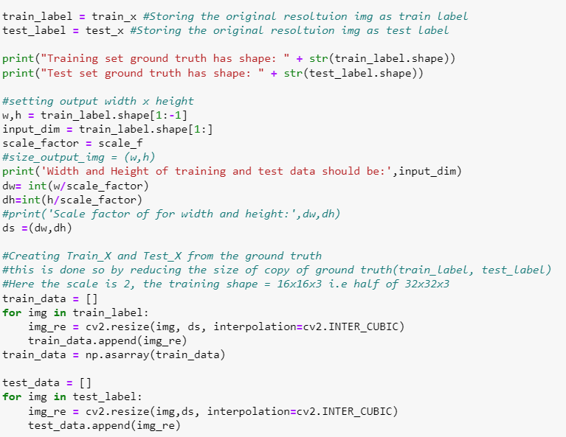
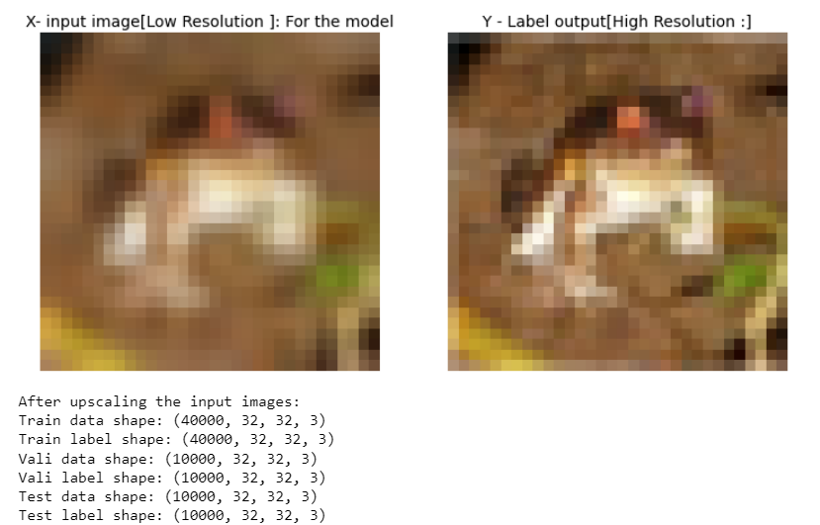
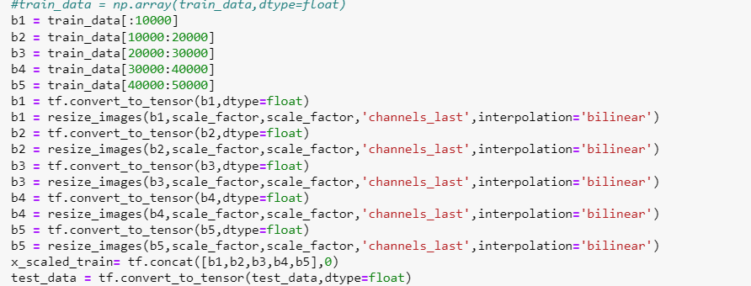
Implementation

Slide 10
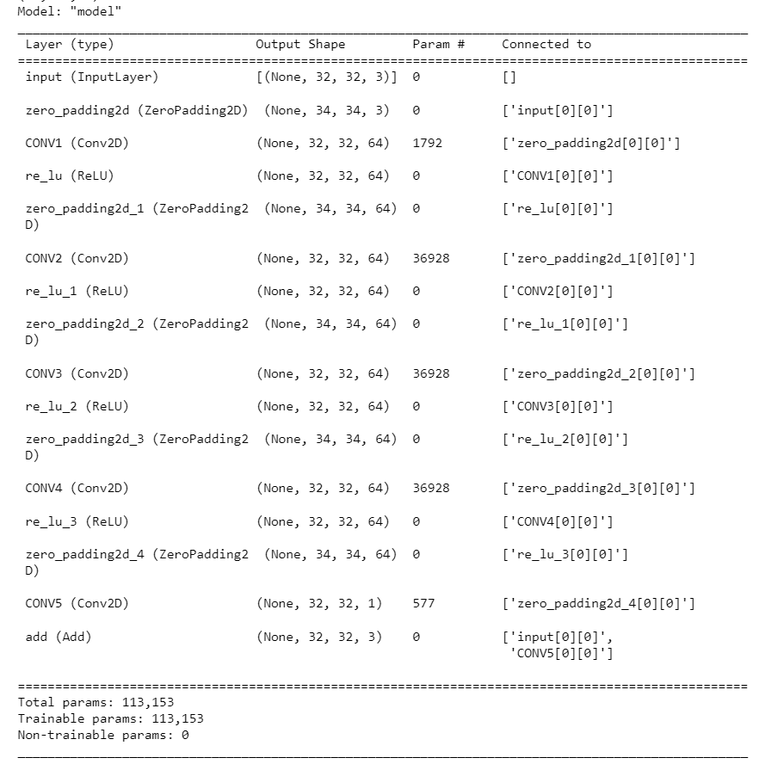
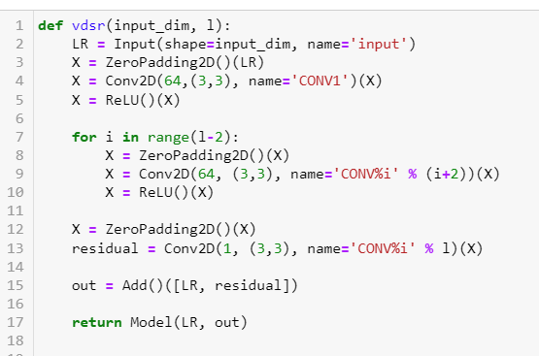

Slide 11
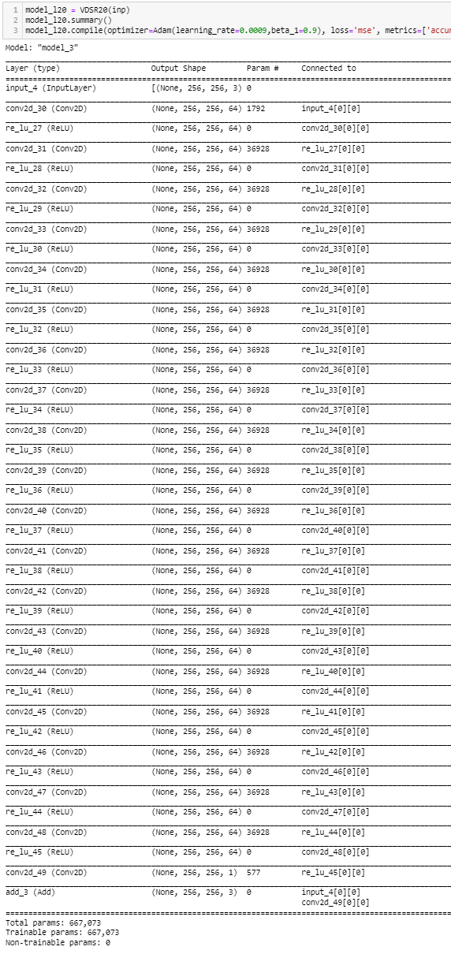
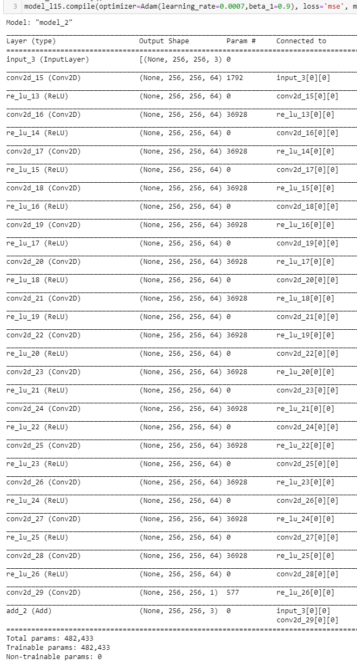
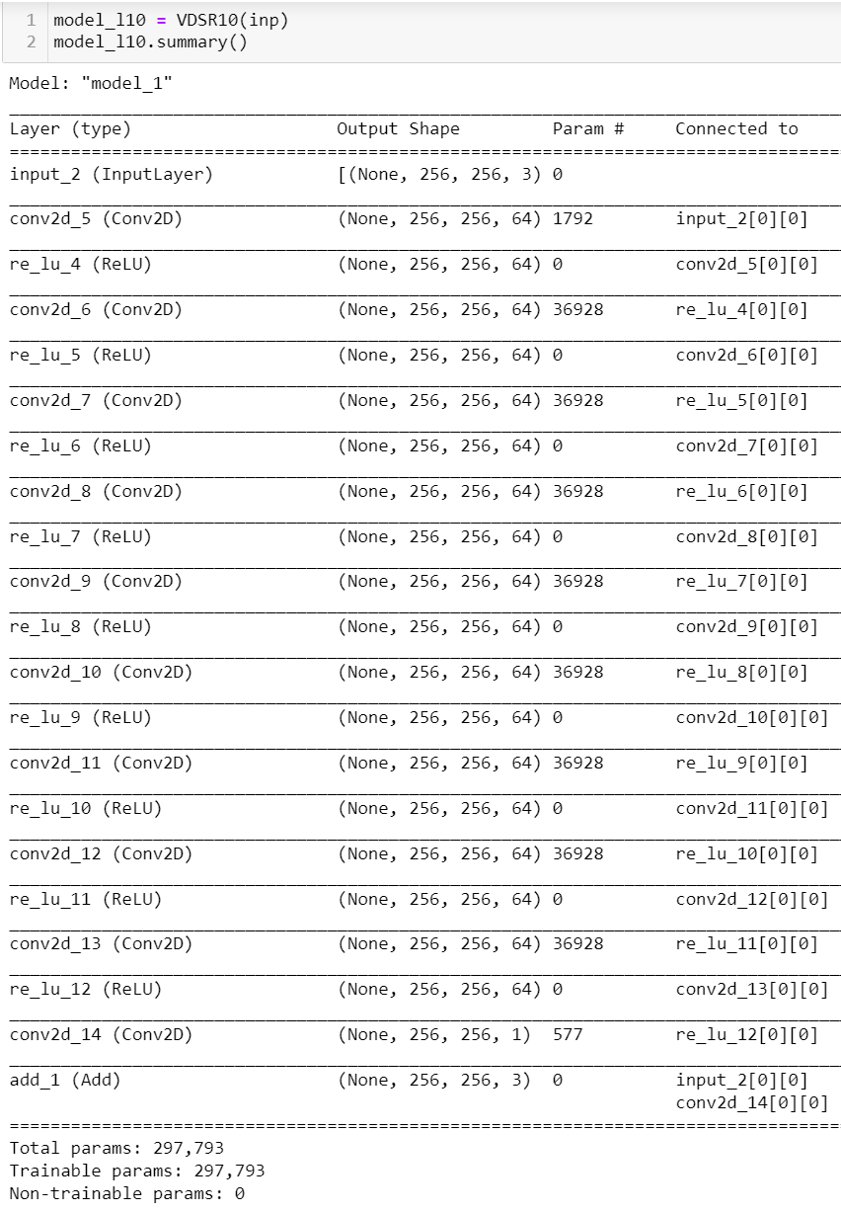
10, 15 and 20 Layer Deep Models

Slide 12
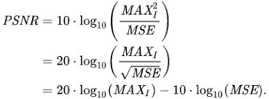
Loss
PSNR : Peak Signal to Noise Ratio

Slide 13
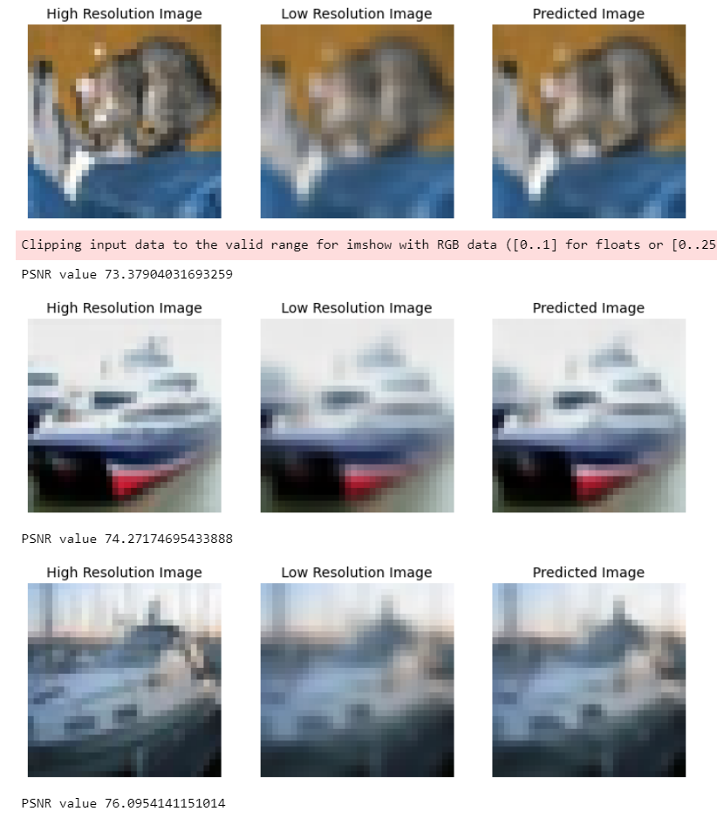
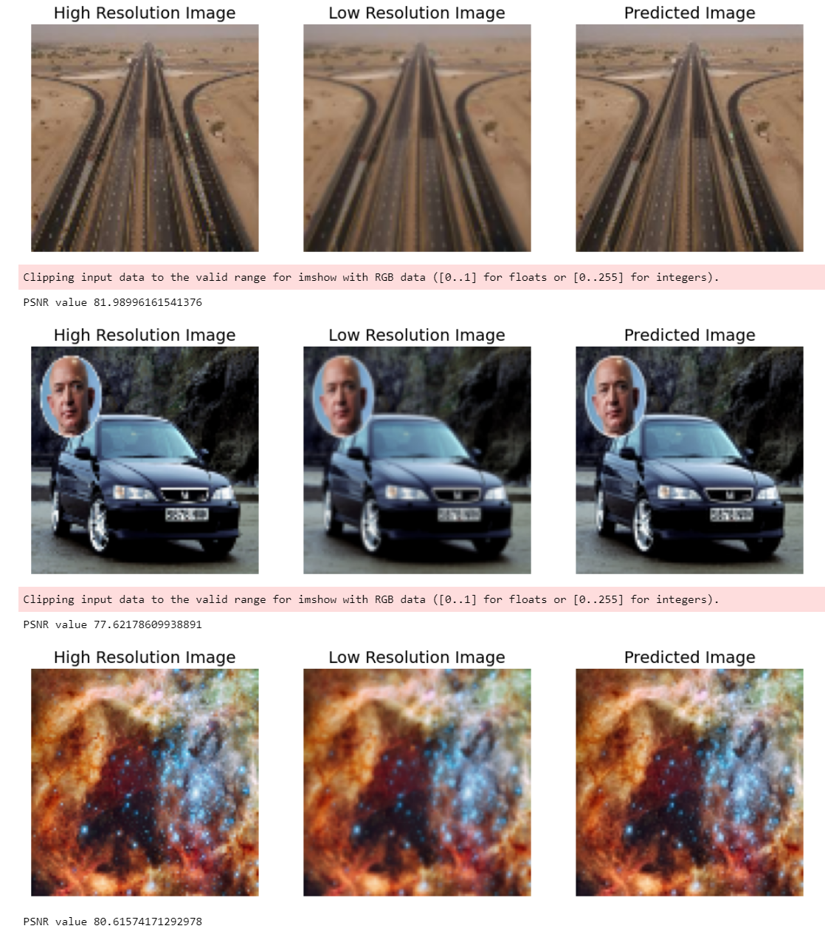
Results and Discussion

Slide 14
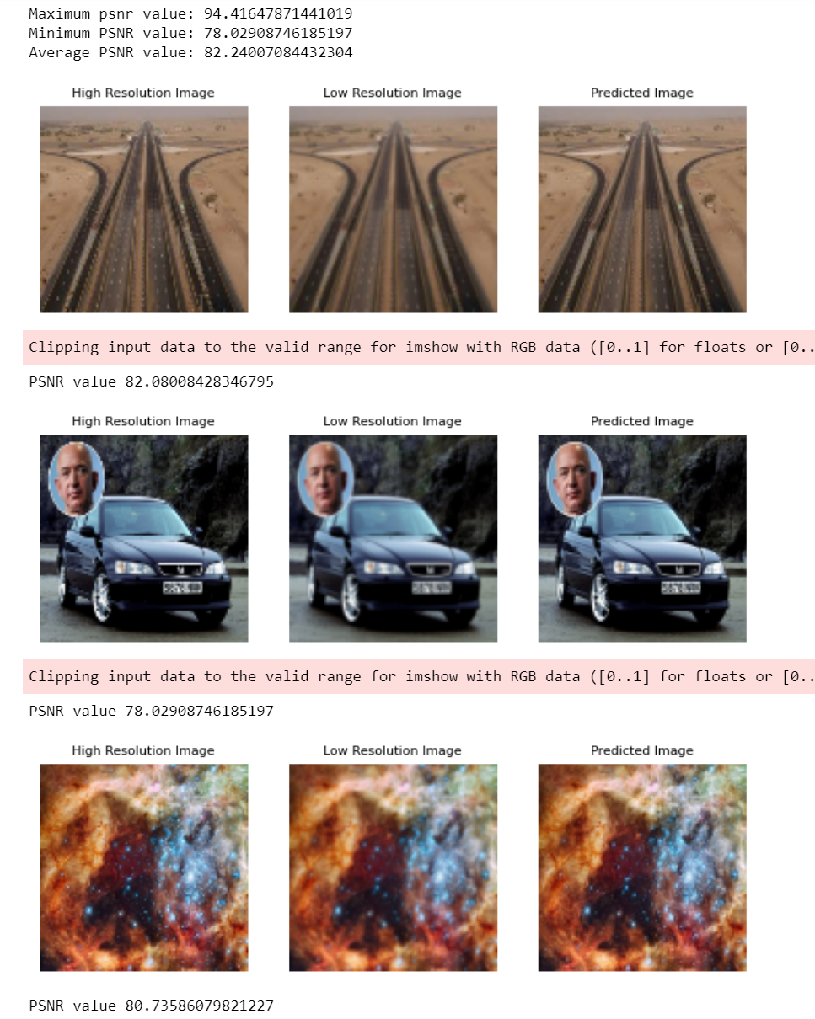
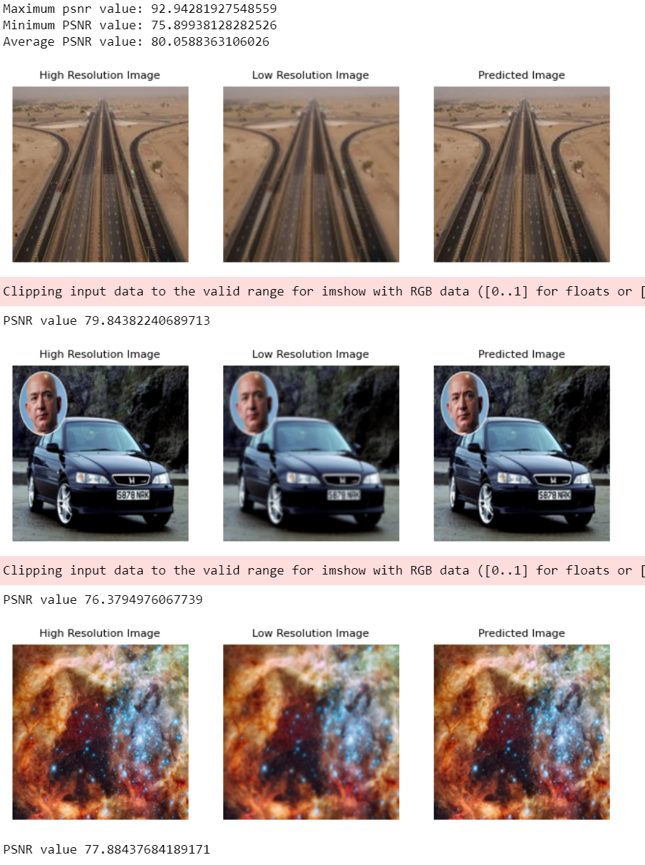
Guess the model?

Slide 15
20 layer Model trained on 100x100x3 images
20 layer Model trained on 256x256x3 images

Slide 16
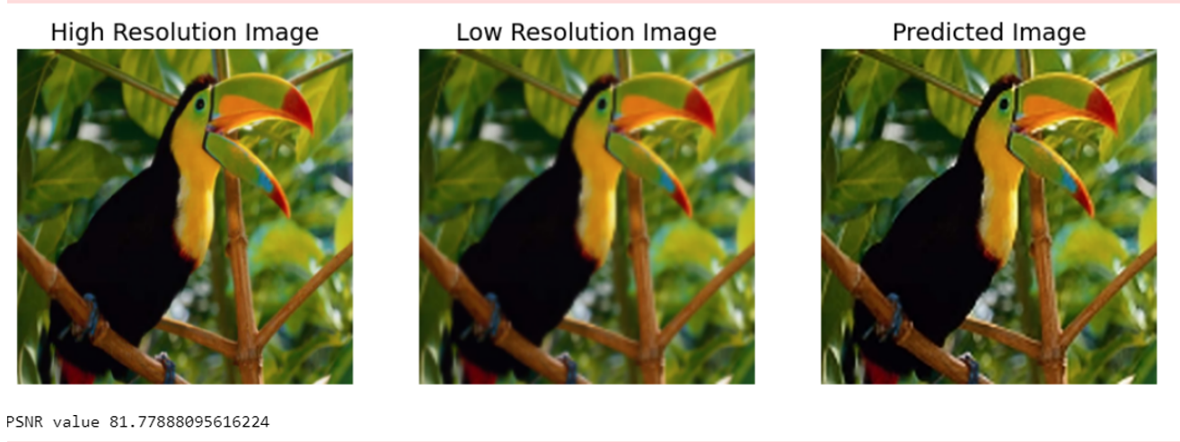
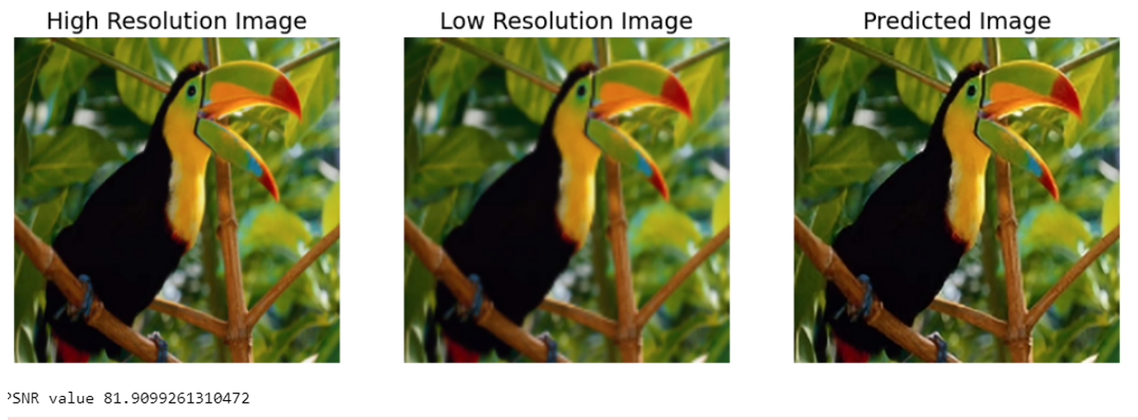

Slide 17
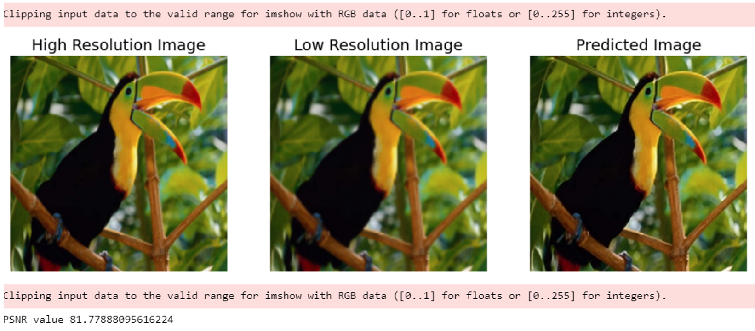
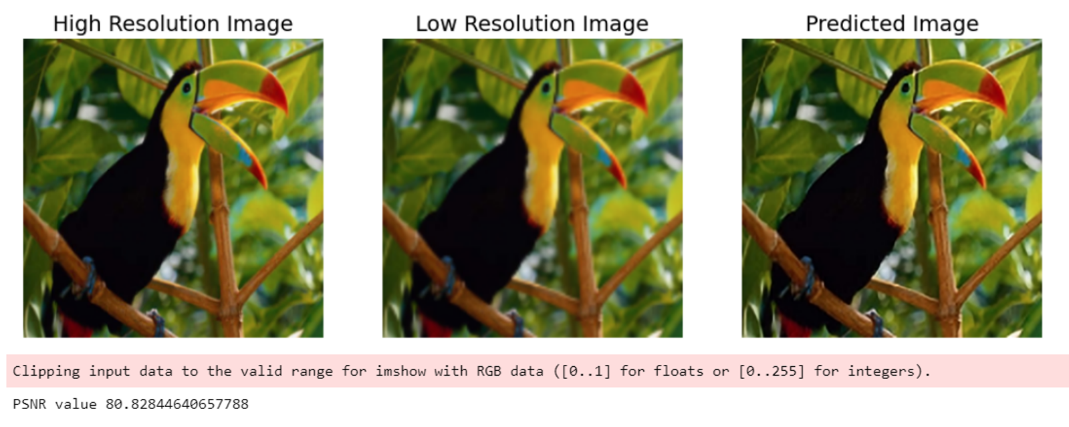

Slide 18
Conclusion
After a certain depth, the predicted image will reach its maximum attainable PSNR score.
An image of size 32x32x3 or 100x100x3 would not be needing all the 20 layers to create a higher resolution image. By our observing the model’s performance we can say, a network of 5 or 10 layers deep is sufficient for small size images.
Images which are larger in size would benefit from having deeper networks.
Training deep networks of depth = 20 or more will be easier to train for smaller images but would require a lot of computation resources for a larger sized image.
We can see the predicted image from 20-layer network, it has sharper edges when compared to the other ones. As we look at bottom edge (near the stomach) region of the bird, we can clearly notice the difference in sharpness produced by the different models. From this we can conclude that lower depth networks provide with a decent PSNR score for small to moderately sized images but to predict finer details for large images, deep networks is a must.

Slide 19
References
https://arxiv.org/pdf/1511.04587.pdf?fbclid=IwAR0gm942jqx5Beq9j3maZ90xeEw4qnWNzToiBUKHFCS7OYgTG__-hl_rx24
http://mmlab.ie.cuhk.edu.hk/projects/SRCNN.html
https://en.wikipedia.org/wiki/Super-resolution_imaging
https://www.google.com/url?sa=i&url=https%3A%2F%2Fen.wikipedia.org%2Fwiki%2FPixel_aspect_ratio&psig=AOvVaw0ohHSfNwsq7YBYPaQEwhaW&ust=1668734123757000&source=images&cd=vfe&ved=0CA8QjRxqFwoTCOiHwomGtPsCFQAAAAAdAAAAABAJ
https://cdn.mos.cms.futurecdn.net/PzPq6Pbn5RqgrWunhEx6rg.jpg
https://miro.medium.com/max/1090/1*auit3UsBTjbnzZoLDEJUUg.png
https://www.scientiamobile.com/wp-content/uploads/2018/12/Pixel-Density.jpg
https://miro.medium.com/max/1060/1*rmQjKd4uETJtwYMRTDzmrg.png
https://www.google.com/url?sa=i&url=https%3A%2F%2Fzentralwerkstatt.org%2Fblog%2Fpulse&psig=AOvVaw09cargbTBiNkZgNnrNz0DO&ust=1668735205473000&source=images&cd=vfe&ved=0CA8QjRxqFwoTCJD445qJtPsCFQAAAAAdAAAAABAK
https://encrypted-tbn0.gstatic.com/images?q=tbn:ANd9GcRePQoj9vCAU-MxGdkQUWxAlVASBjLWZsFuFewuKnbSnwwEaKpuRV5MM7TtwIpG1PIRnWo&usqp=CAU

Slide 20
Thank you
fin

